Slide 1
Some notes on Energy
Energy [J = N.m] is a measure used by scientists to describe the capacity of a system (e.g., a volume of fluid) to do work.
work [J = N.m] is defined as the result of application of a force (gravitational, electromagnetic, etc.) through a physical distance.
Kinetic energy is energy due to the motion of a volume of a fluid.
Potential energy is the energy due to the position of a volume of fluid relative to other volume of fluid.

Slide 2
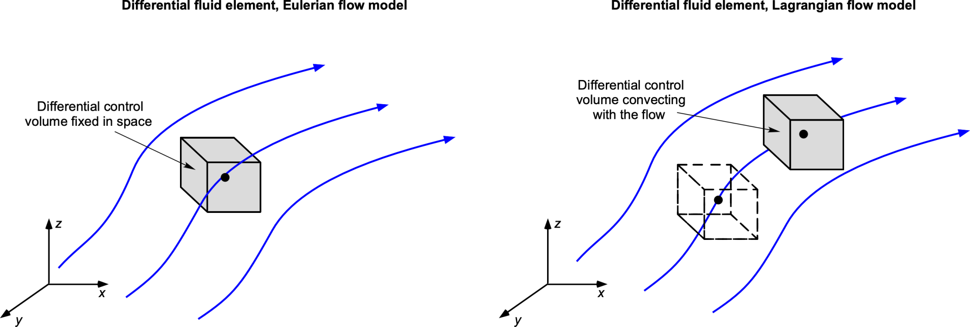
Fluid Dynamics
Streamline
Streamtube

Slide 3
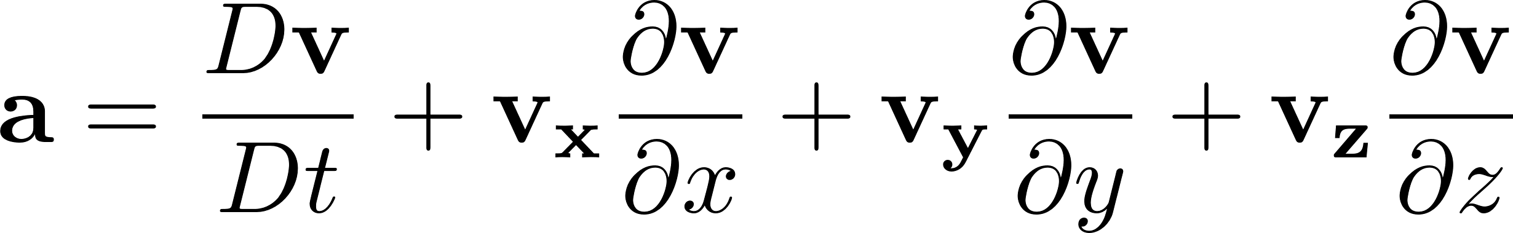
Some notes on Derivatives
Partial time derivative: temporal change of T (temperature) at a given fixed coordinate system (x,y).
or
For water or any fluid, the acceleration a(x,y,z,t) can then be written as:
Substantial Derivative

Slide 4
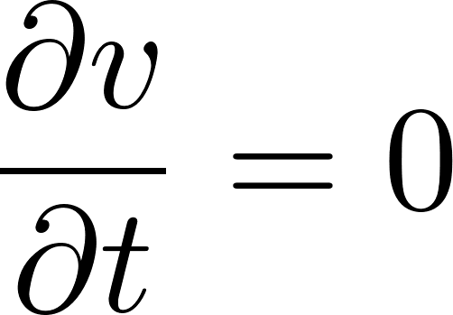
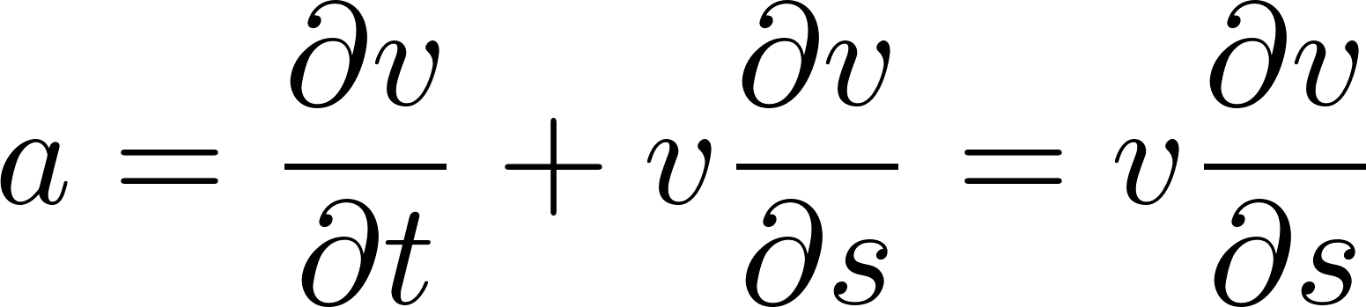
Brief Flow Classification
For steady flow alongside the streamline:
Which results in the total acceleration a equals:
s: streamline axis

Slide 5
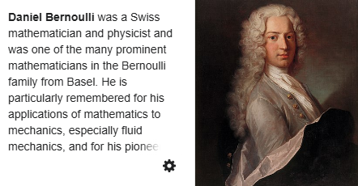
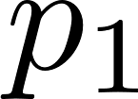


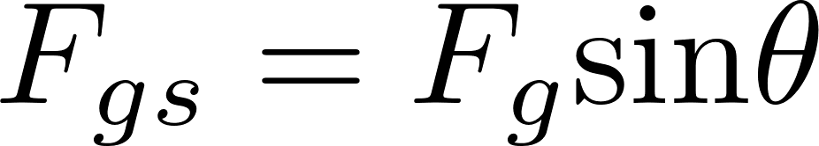
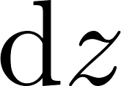
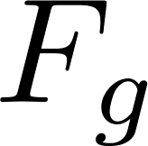
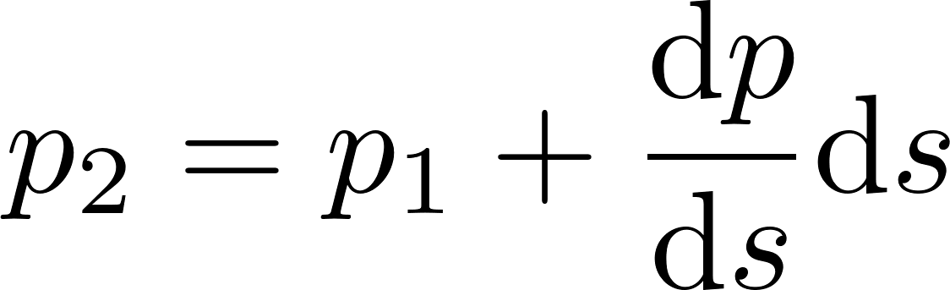
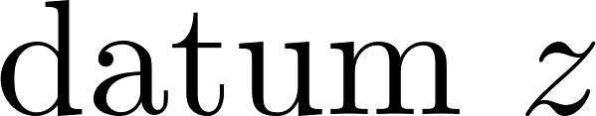

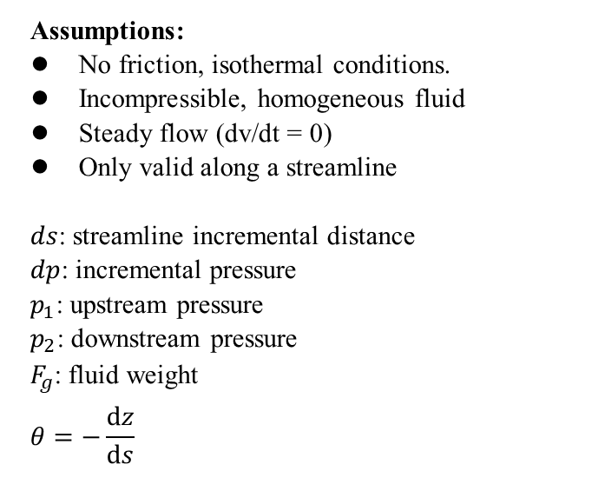
Fluid Dynamics: Bernoulli’s Equation
Assumptions:
No friction, isothermal conditions.
Incompressible, homogeneous fluid
Steady flow (dv/dt = 0)
Only valid along a streamline
$ds$: streamline incremental distance
$dp$: incremental pressure
$p_{1}$: upstream pressure
$p_{2}$: downstream pressure
$F_{g}$: fluid weight
$$θ=−\frac{dz}{ds}$$
(1700-1782)

Slide 6
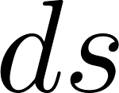
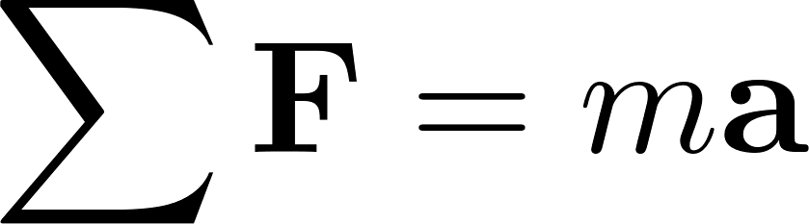
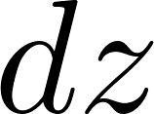
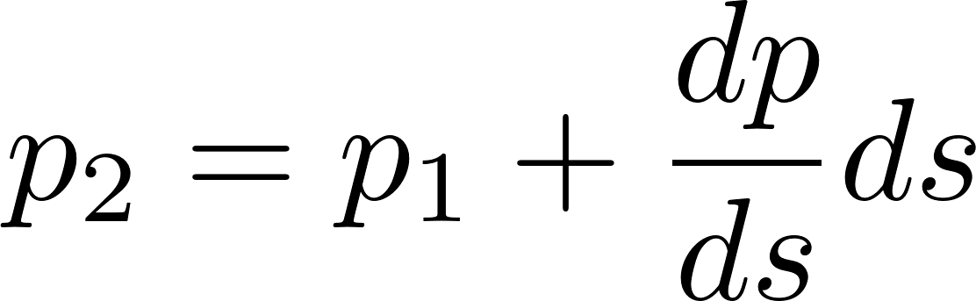
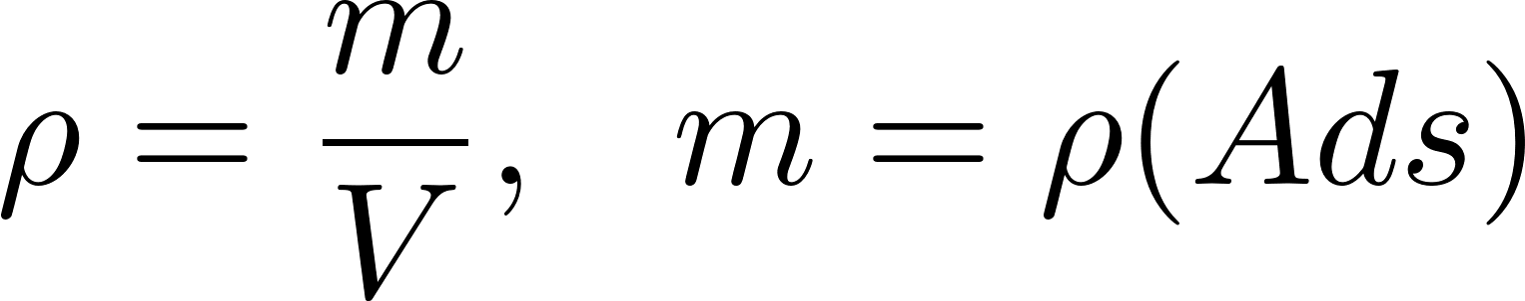
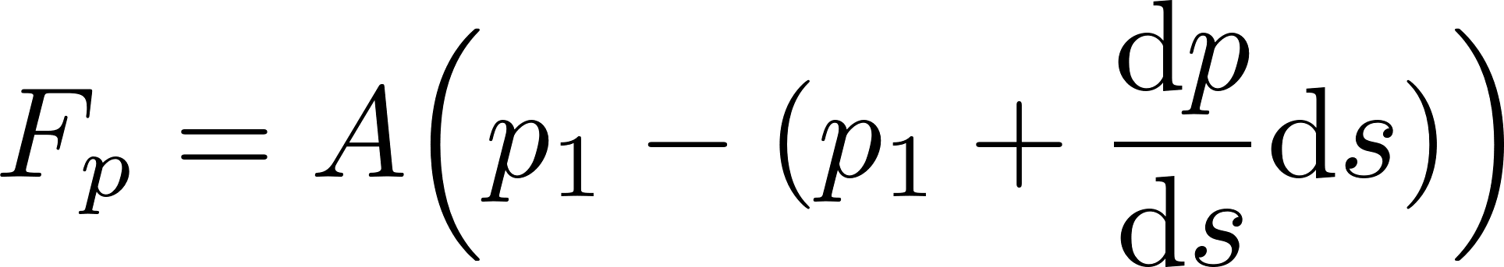
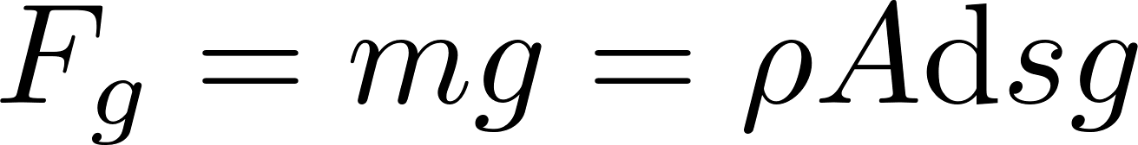
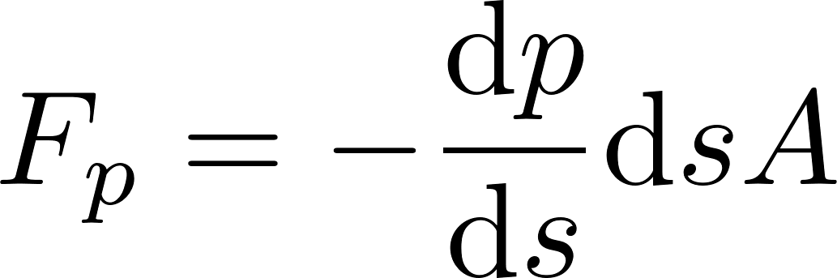
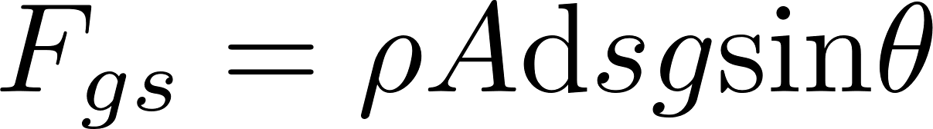
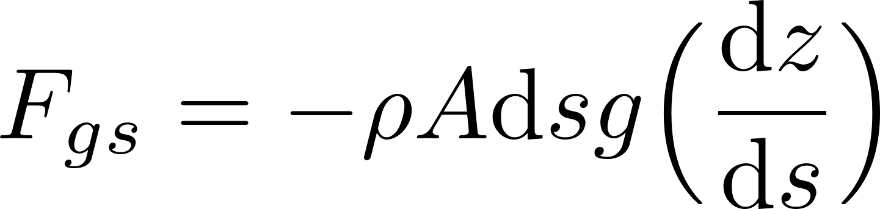
Fluid Dynamics: Bernoulli’s Equation
From the density definition:
Surface Force
Body Force

Slide 7
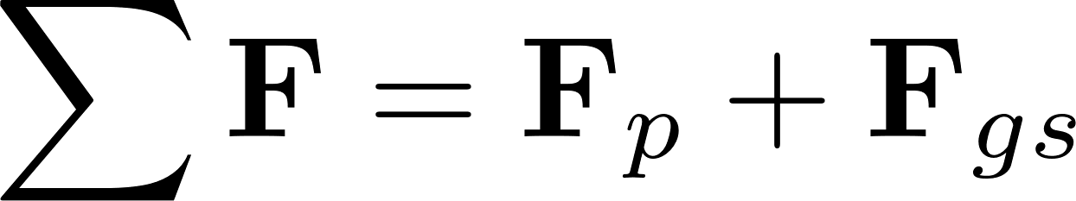
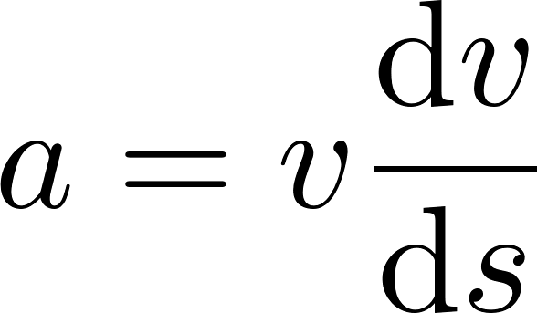
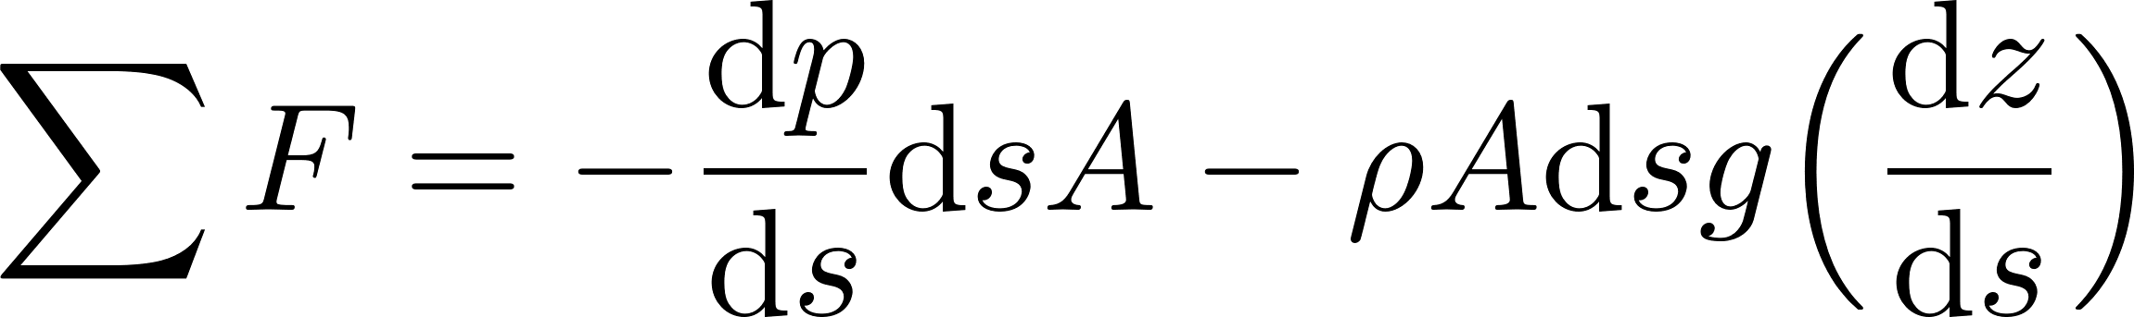
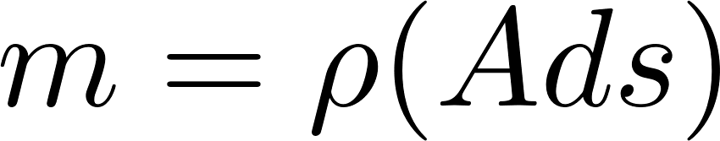
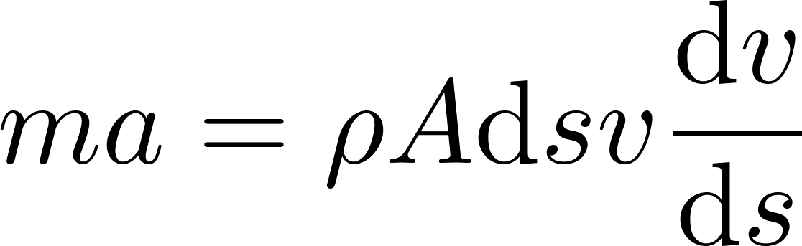

Fluid Dynamics: Bernoulli’s Equation
Because we assume no friction forces, the resulting force alongside the streamline is:
For steady-state
So $ma$ becomes

Slide 8
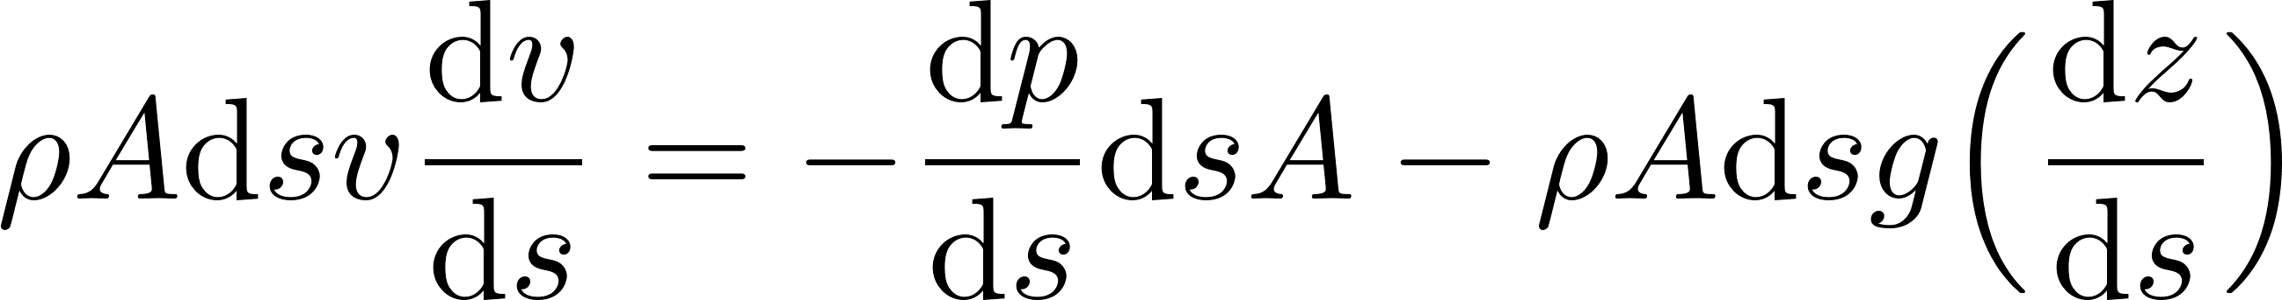
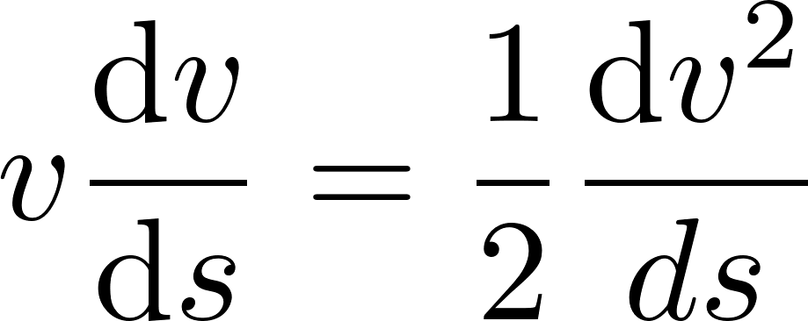
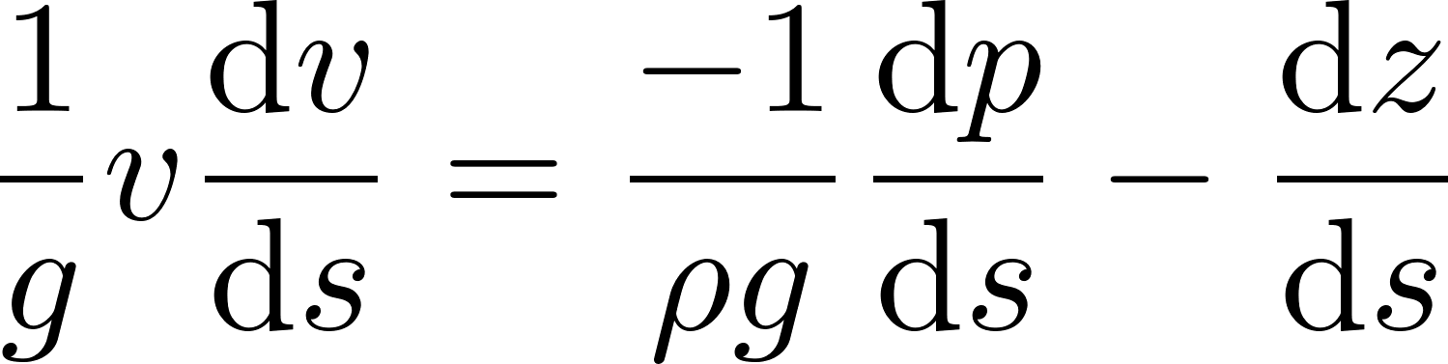
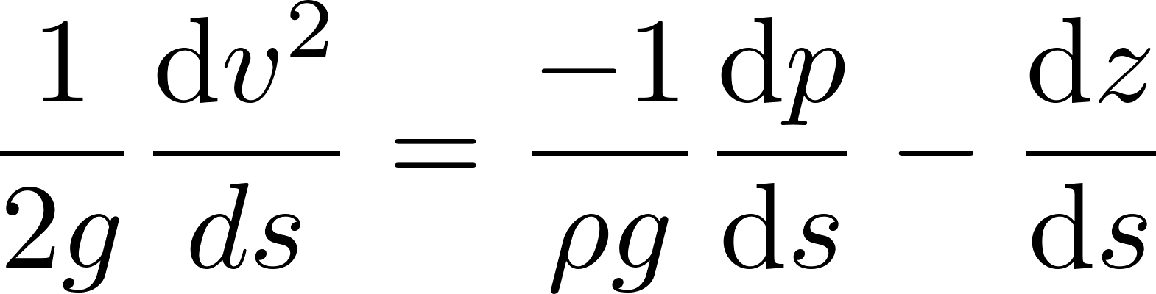
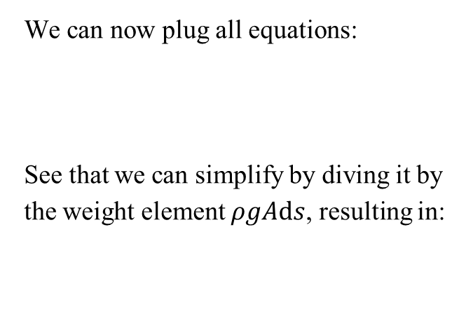
Fluid Dynamics: Bernoulli’s Equation
We can now plug all equations:
See that we can simplify by diving it by the weight element $ρgAds$, resulting in:
Just a final little trick

Slide 9
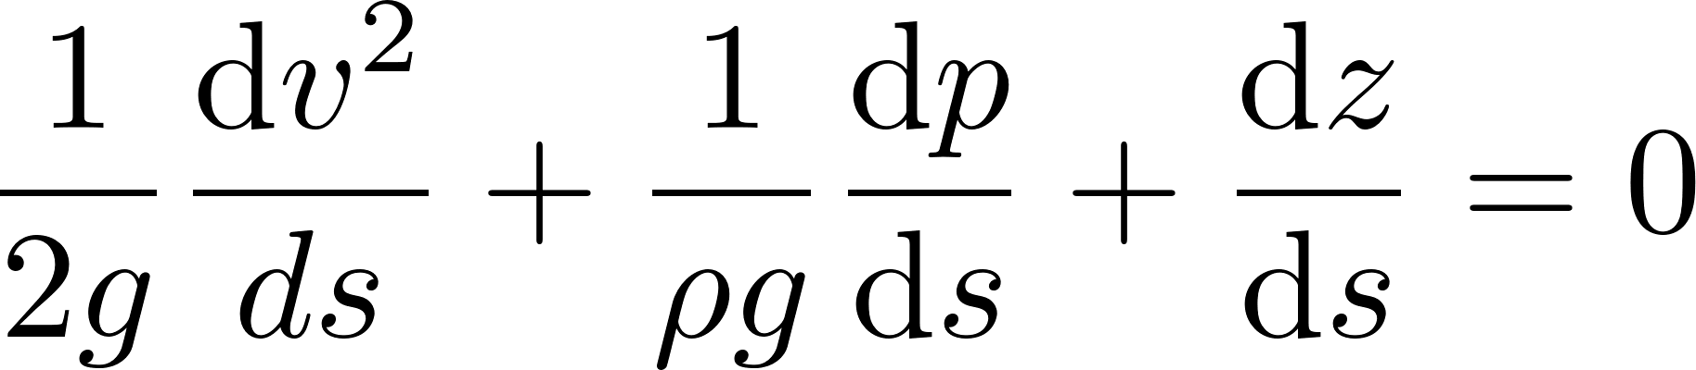
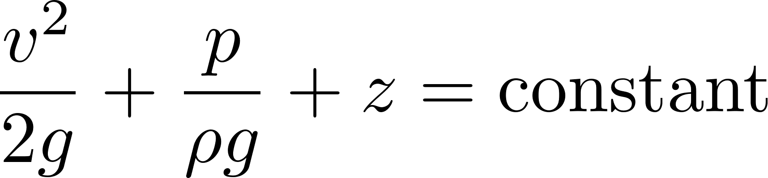
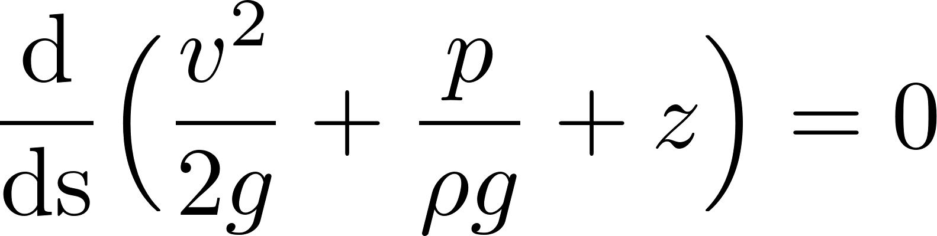
Fluid Dynamics: Bernoulli’s Equation
Since all terms now are a derivative of s, we can join both sides of the equation as:
Integrating both sides of the equation:
Bernoulli’s equation for isothermal, incompressible steady flow

Slide 10
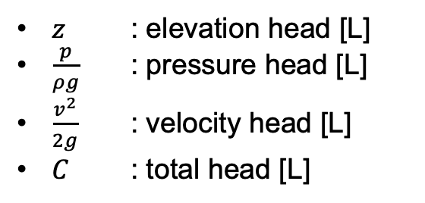
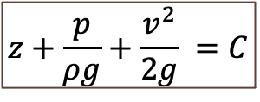
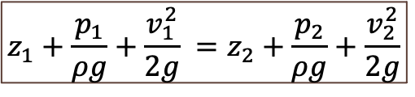
Fluid Dynamics: Bernoulli’s Equation
$$z+\frac{p}{ρg}+\frac{v^{2}}{2g} =C$$
$z$ : elevation head [L]
$\frac{p}{ρg}$ : pressure head [L]
$\frac{v^{2}}{2g}$ : velocity head [L]
$C$ : total head [L]
$$z_{1}+\frac{p_{1}}{ρg}+\frac{v_{1}^{2}}{2g} =z_{2}+\frac{p_{2}}{ρg}+\frac{v_{2}^{2}}{2g}$$

Slide 11
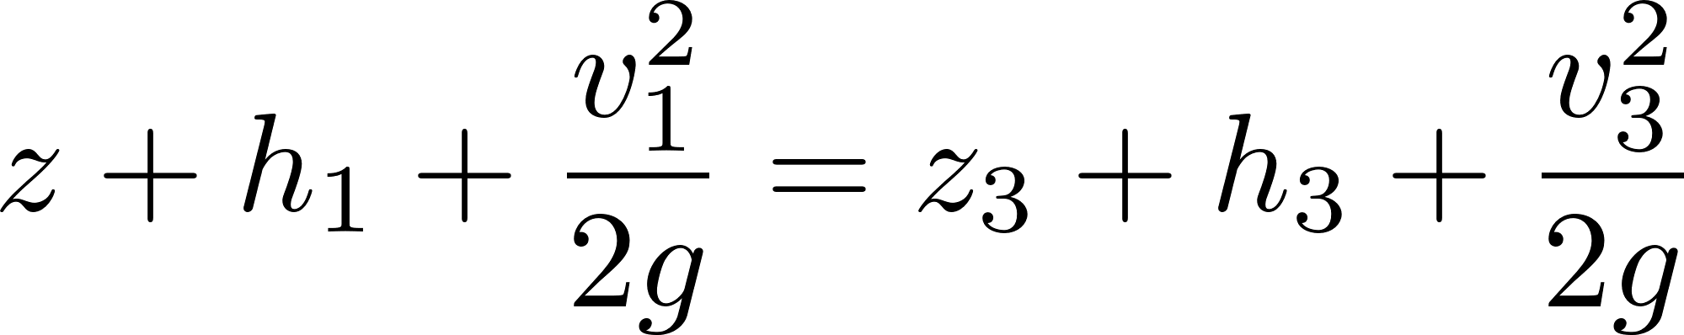
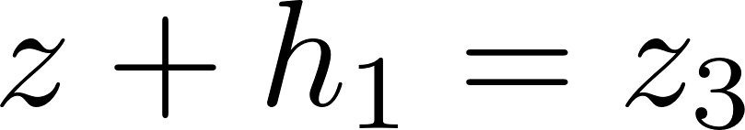
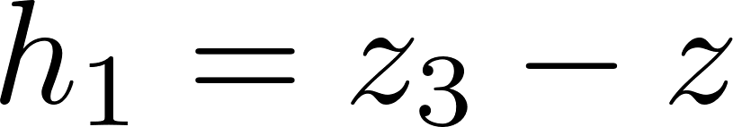
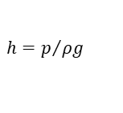
Fluid Dynamics: Manometers
In a manometer, there is a linear balance between pressure head and elevation
Let’s apply Bernoulli’s equation from 1 to 3
$$h=p/{ρg}$$
Therefore, the pressure head in 1 is just the water column up to 3

Slide 12
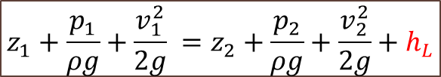
Fluid Dynamics: Head Losses
$$z_{1}+\frac{p_{1}}{ρg}+\frac{v_{1}^{2}}{2g} =z_{2}+\frac{p_{2}}{ρg}+\frac{v_{2}^{2}}{2g}+h_{L}$$

Slide 13
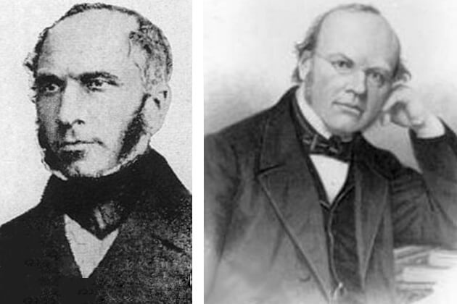
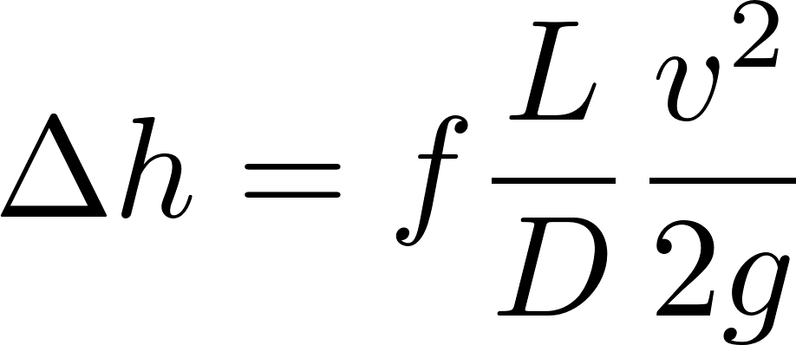
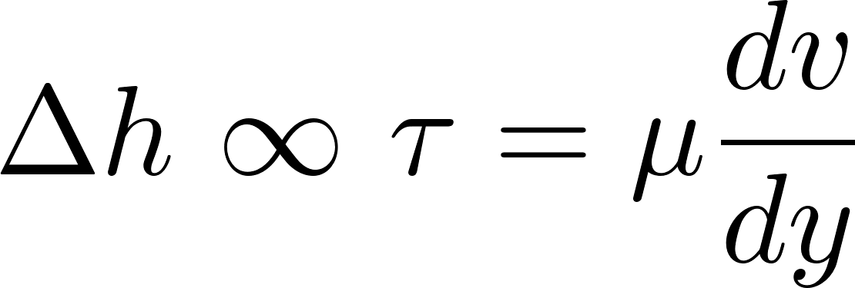
Fluid Dynamics: Head Losses
Where:
f: friction factor (depends on material properties and flow characteristics)
L: distance alongside the streamline
v: steady flow velocity
D: pipe hydraulic diameter
Henry Darcy
(1803-1858)
French Engineer
Julius Weisbach (1806-1871)
German Mathematician

Slide 14
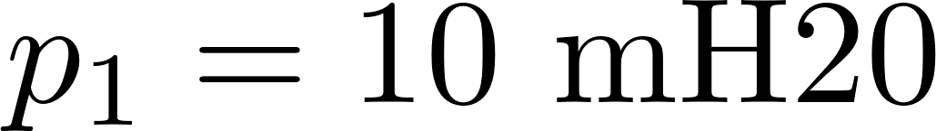
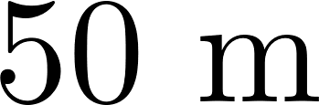


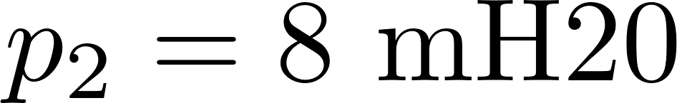

Fluid Dynamics: Head Losses
Water at 20 °C (ρ ≈ 1000 kg/m³) flows steadily through a horizontal straight pipe of length 𝐿=50 m, 0.5% slope, and diameter 𝐷=0.10 m. The upstream gauge pressure is 𝑝₁=10 mH₂0, and the downstream gauge pressure is 𝑝₂= 8 mH₂0. The friction factor can be assumed as 𝑓=0.020. Neglect minor losses. Find the volumetric flow rate 𝑄.
(1)
(2)

Slide 15




Fluid Dynamics: Head Losses
Let’s apply Bernoulli’s equation with head losses from (1) to (2)
Steady-state

